Slide 1

Big Data and Internet of Things(IoT)
”How could the synergy of big data analytics, the Internet of Things (IoT), reshape football strategies, player performance analysis, and fan engagement? Additionally, what forthcoming challenges might arise in unlocking the complete potential of big data and IoT in the football industry?”

Slide 2
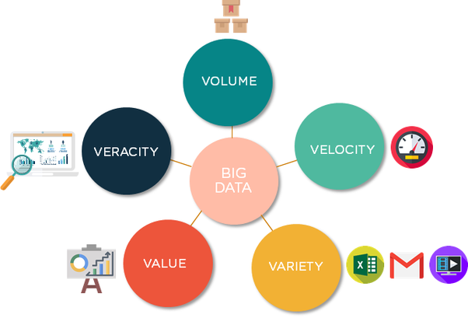

What is Big Data & Internet of Things(IoT)?
(esupermk.live, n.d.)
(Muha, 2019)

Slide 3
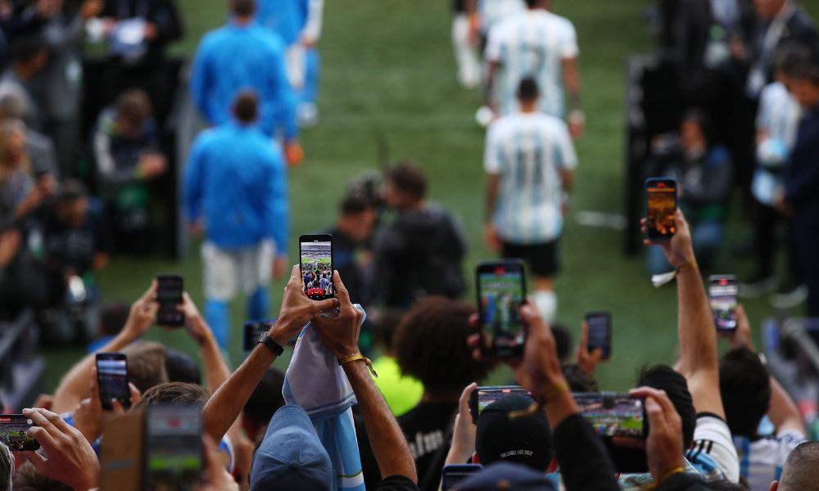
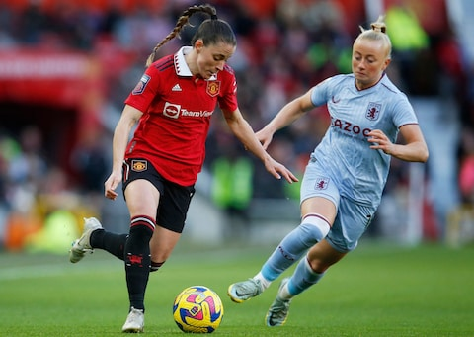
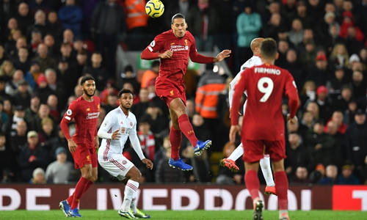
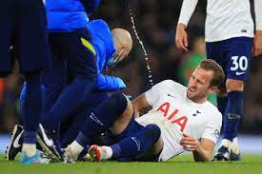
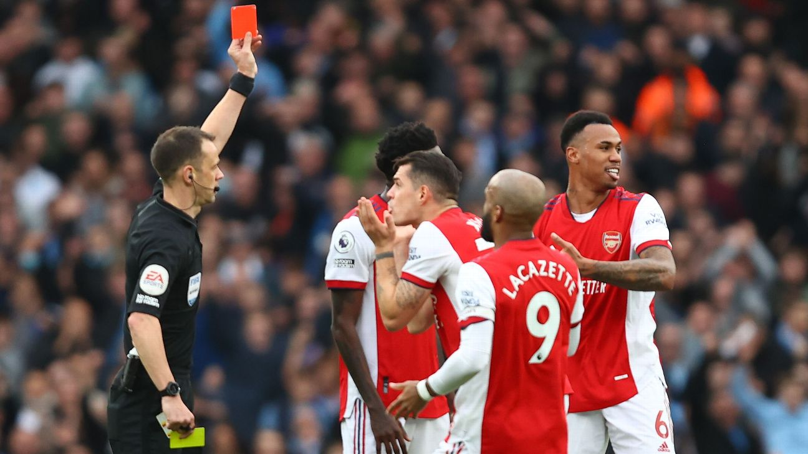
Football & Data
(Wenao, n.d.)
(Garry, 2022)
(McCaskill, 2022)
“Each game collects 1.4million data sets.” (Big Cloud, 2016)
(Football Today, n.d.)
(ESPN.com, 2022)

Slide 4
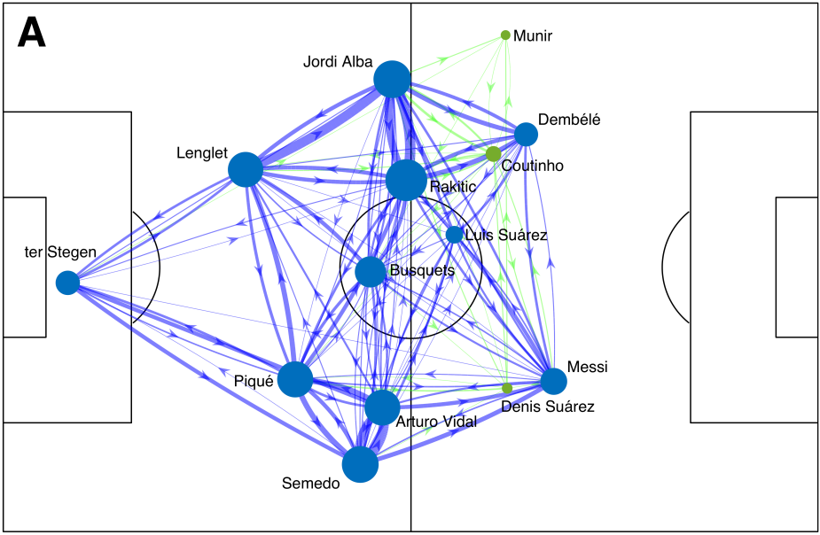
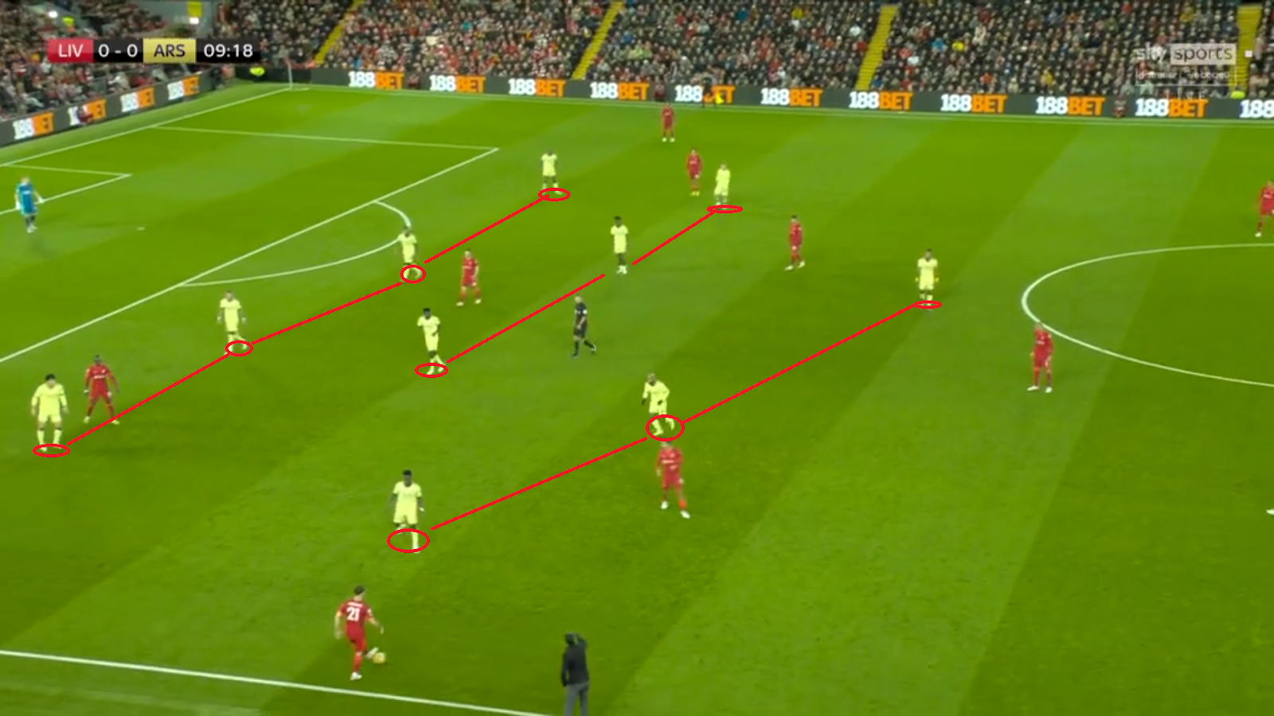
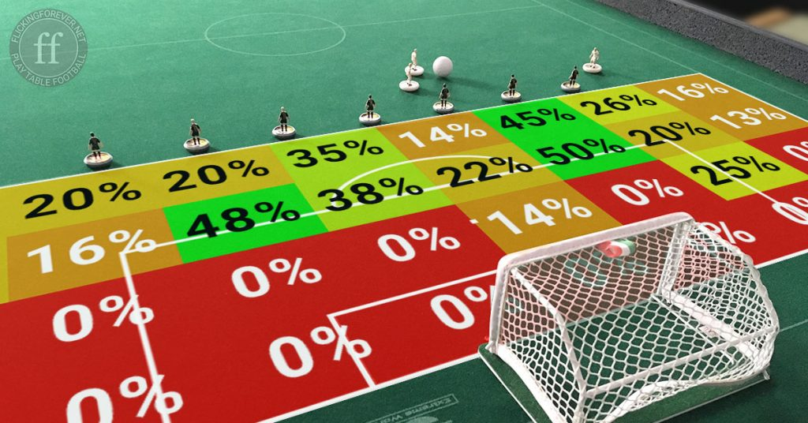
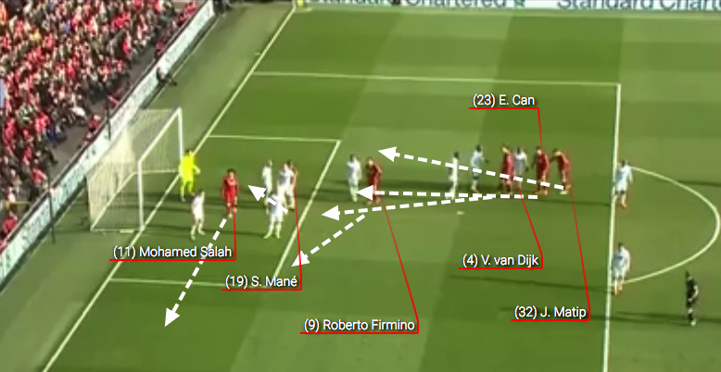

Revolutionizing Football Aspects
Tactical Insights
Passing Networks
Defensive Shapes
Shooting Analysis
(Gallagher, 2021)
(Felices, 2023)
(FC, 2022)
Set-Piece Analysis
Duels & Challenges
And many more…
(Rhodes, 2018)
(Worville, n.d.)

Slide 5
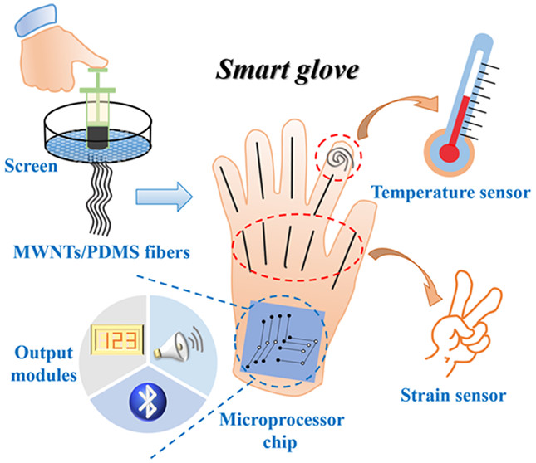
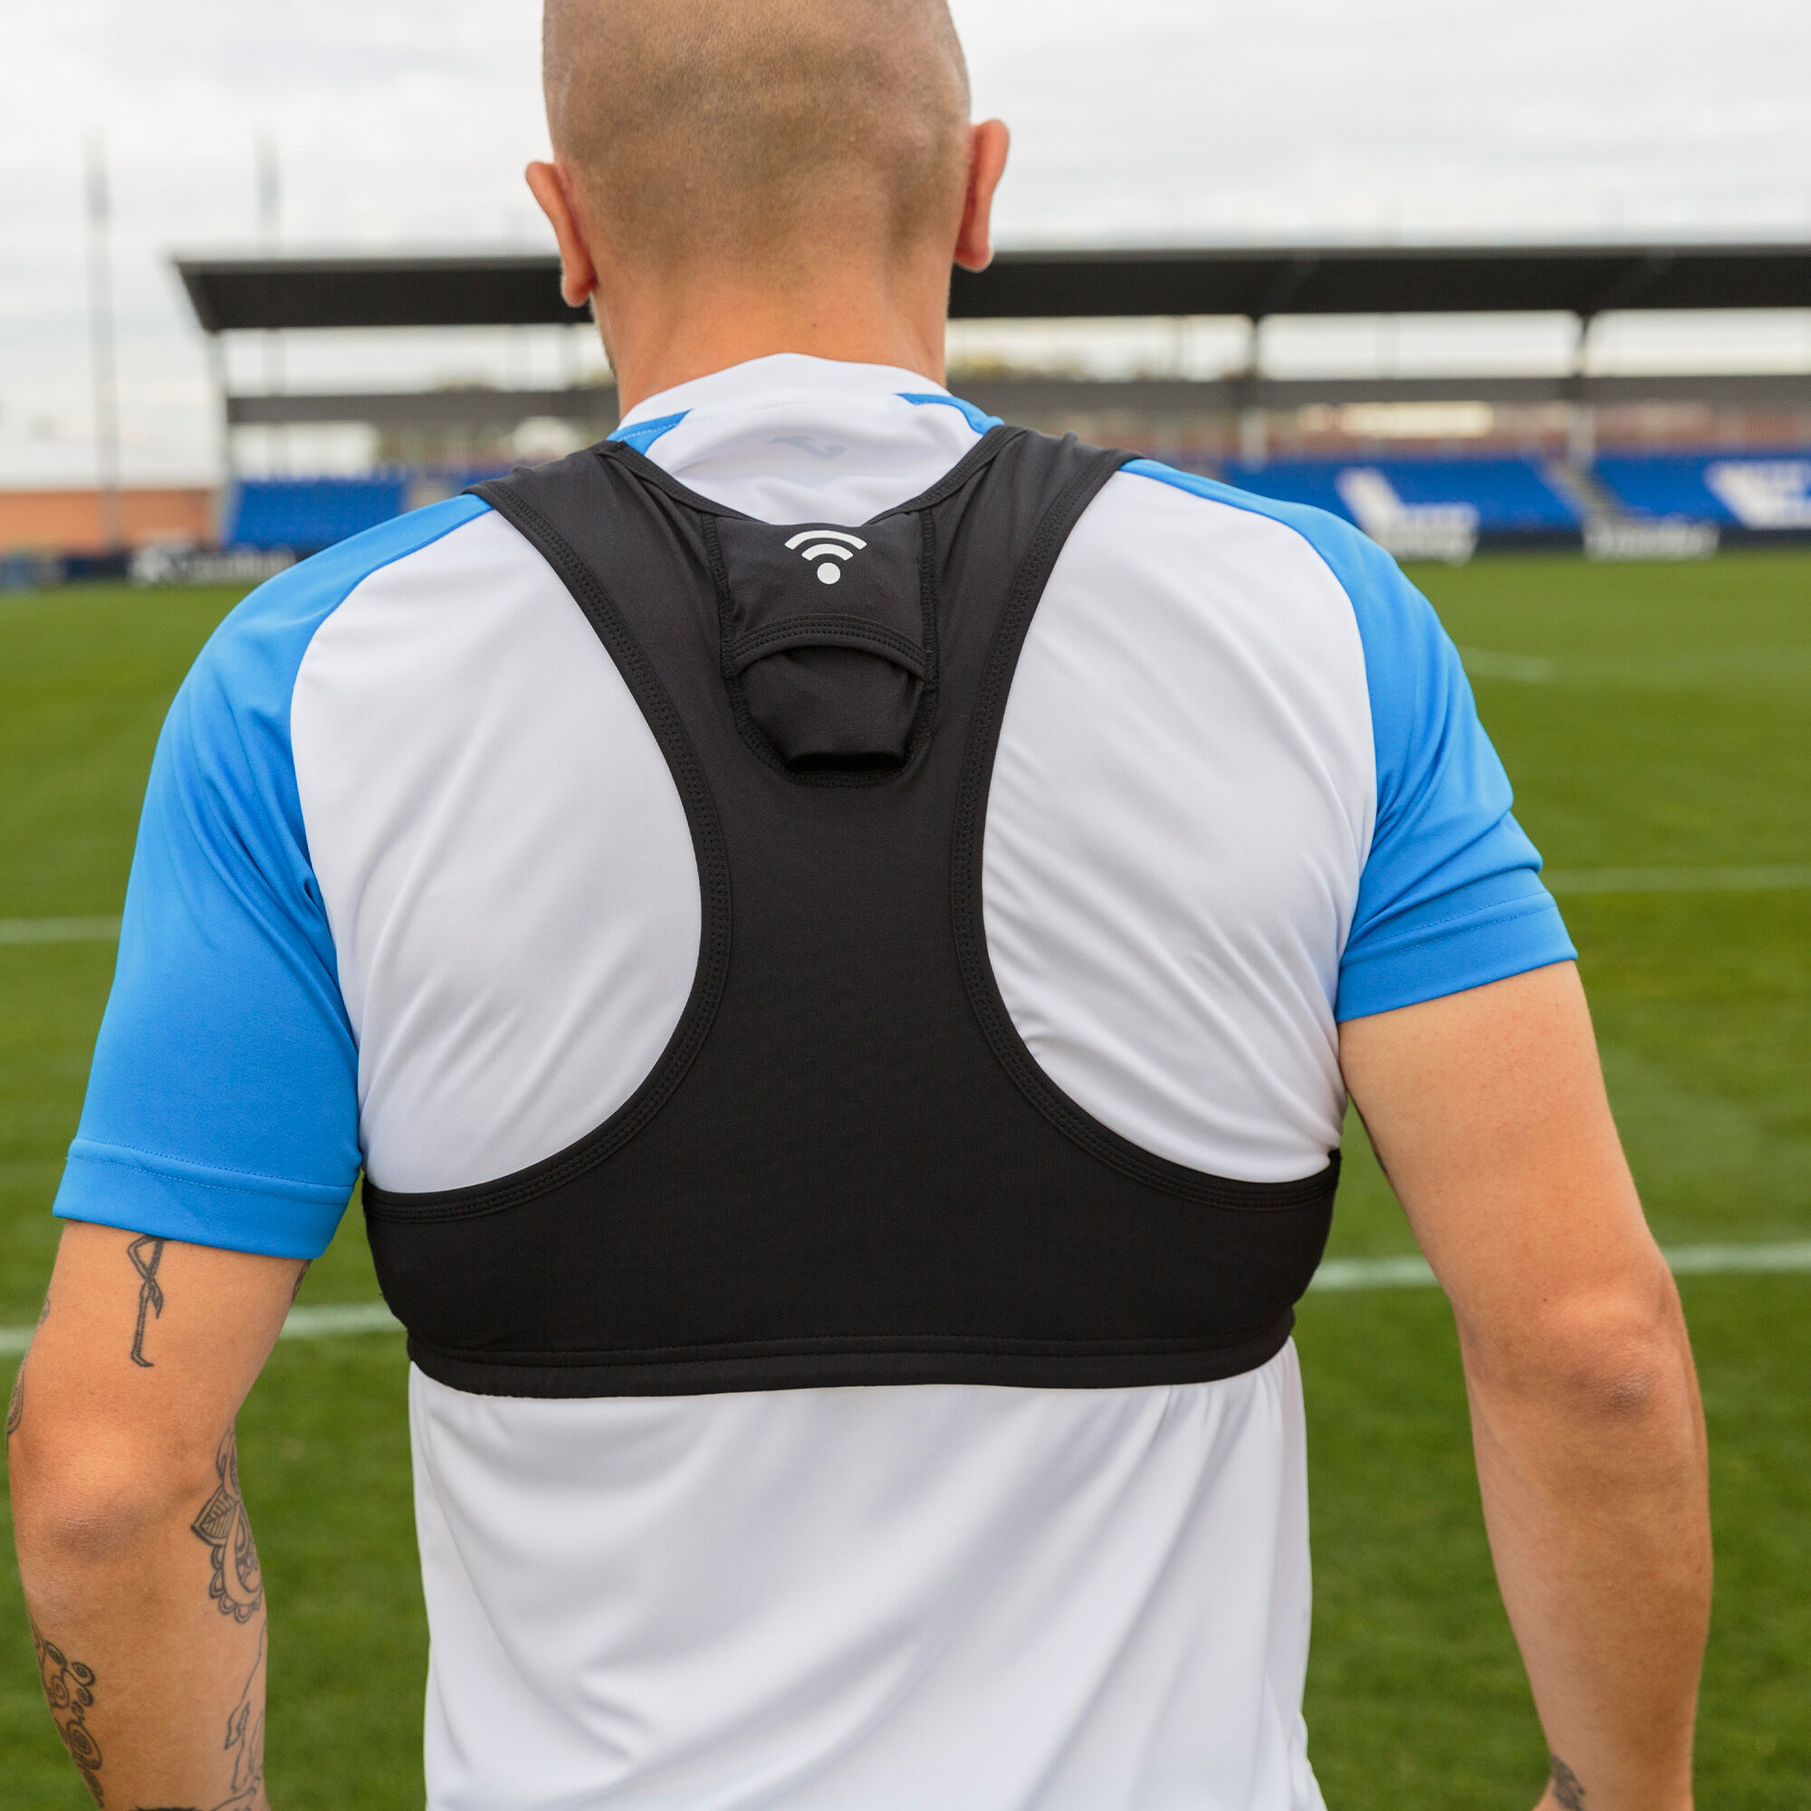
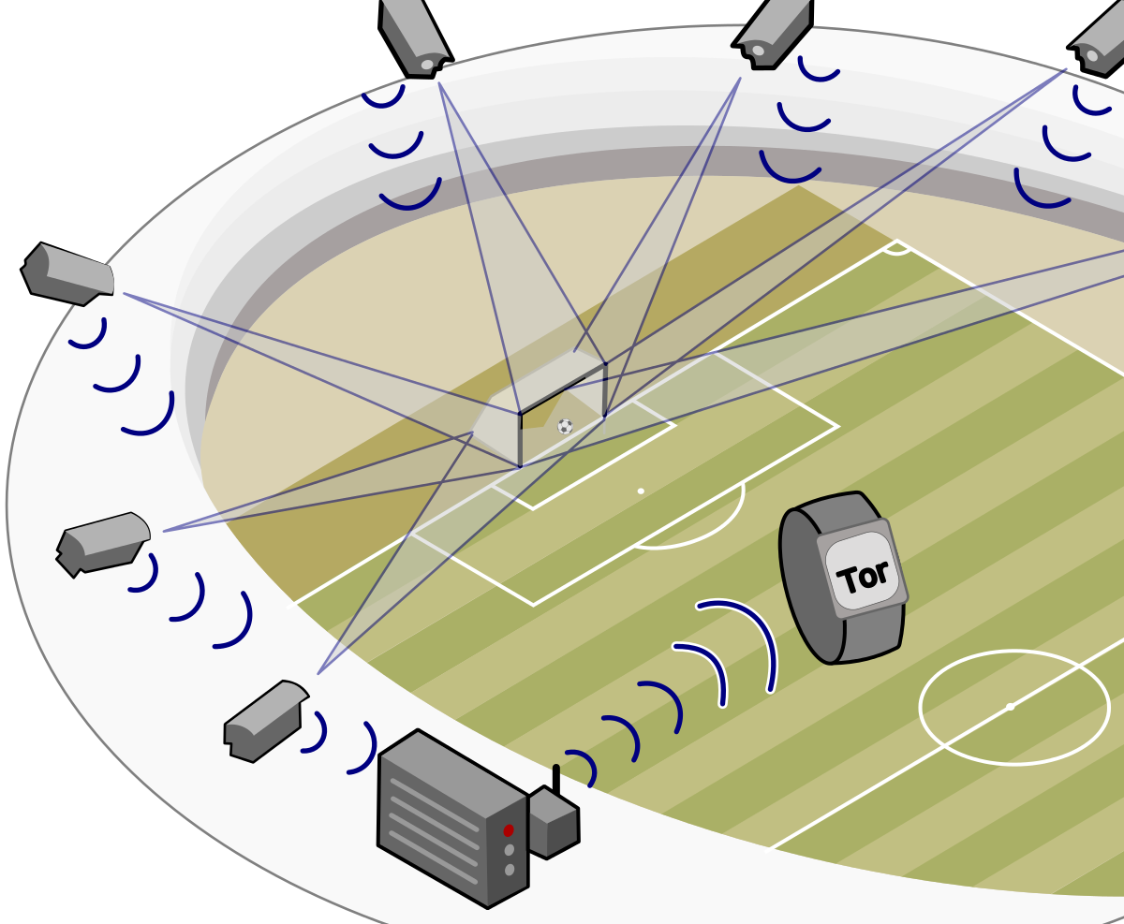
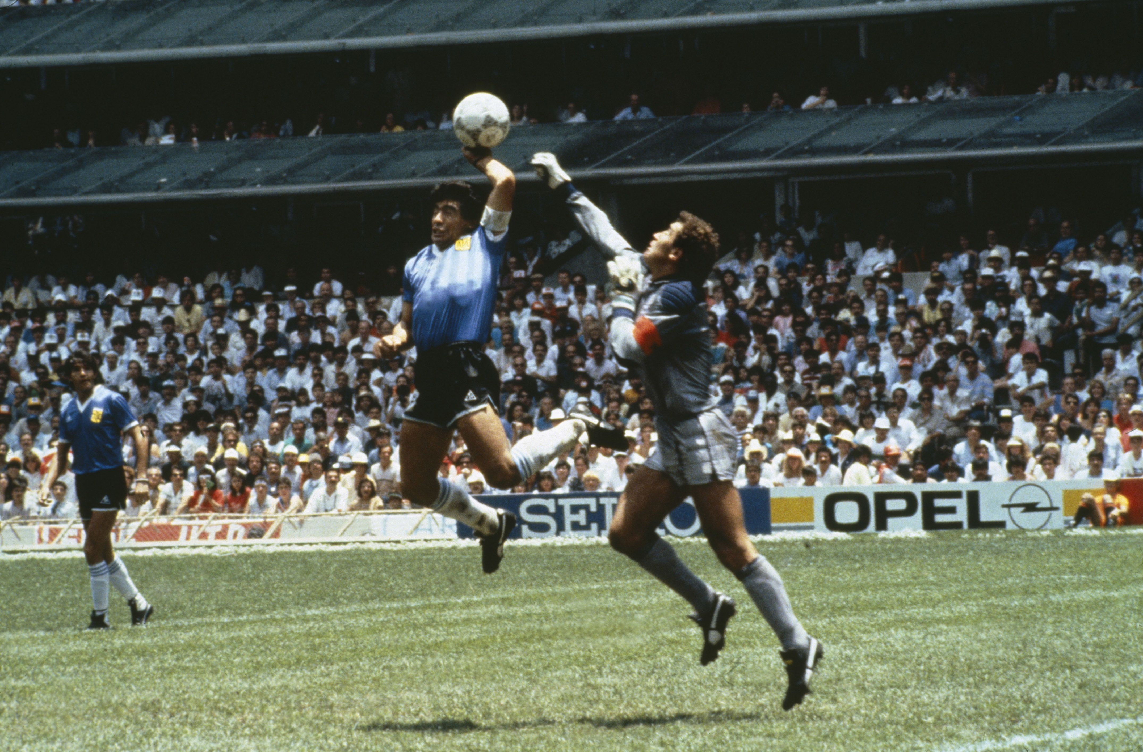
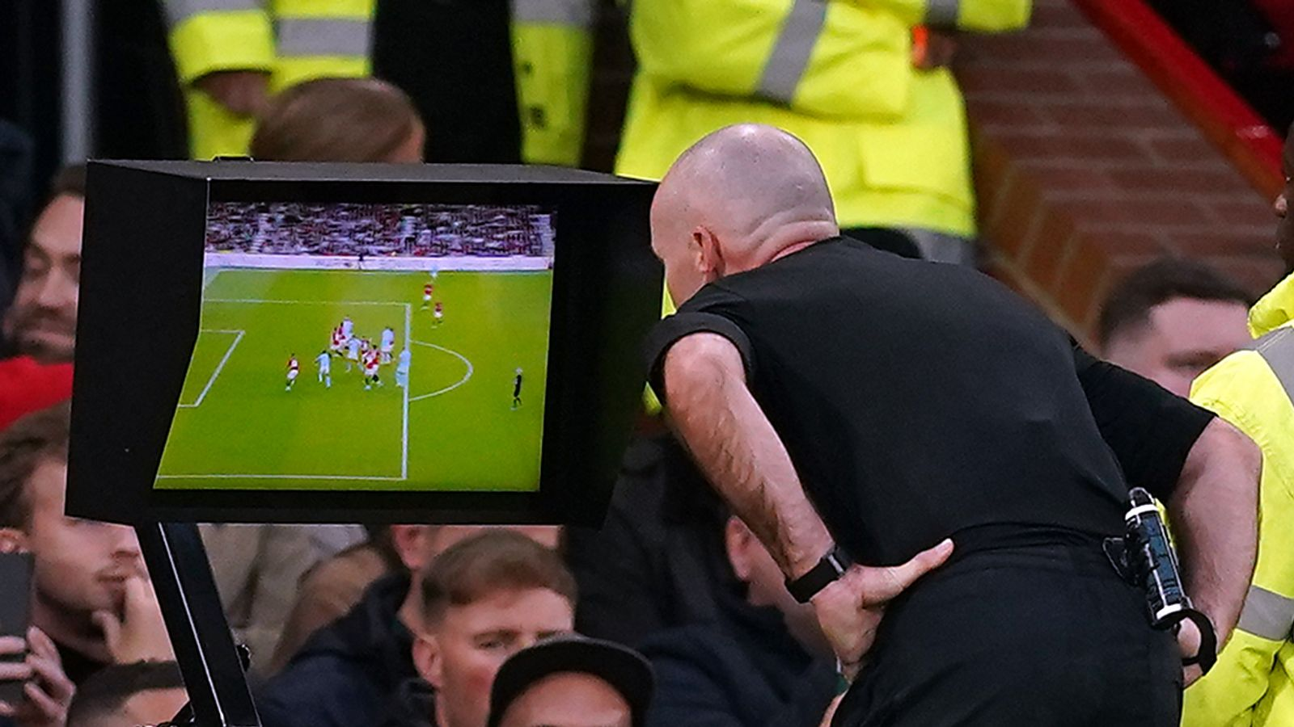
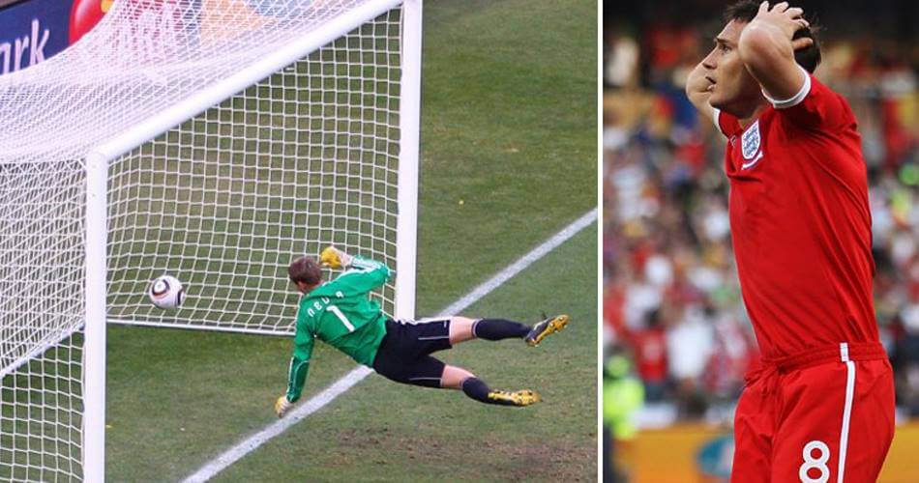
Revolutionizing Football Aspects
Devices & Sensors
GPS Vest
Goal Line Technology
(Li et al., 2020)
(www.joma-sport.com, n.d.)
(Wikipedia Contributors, 2019)
Video Assistant Referee
(Sky Sports, n.d.)
(Ramsay, 2022)
(www.sportbible.com, n.d.)

Slide 6
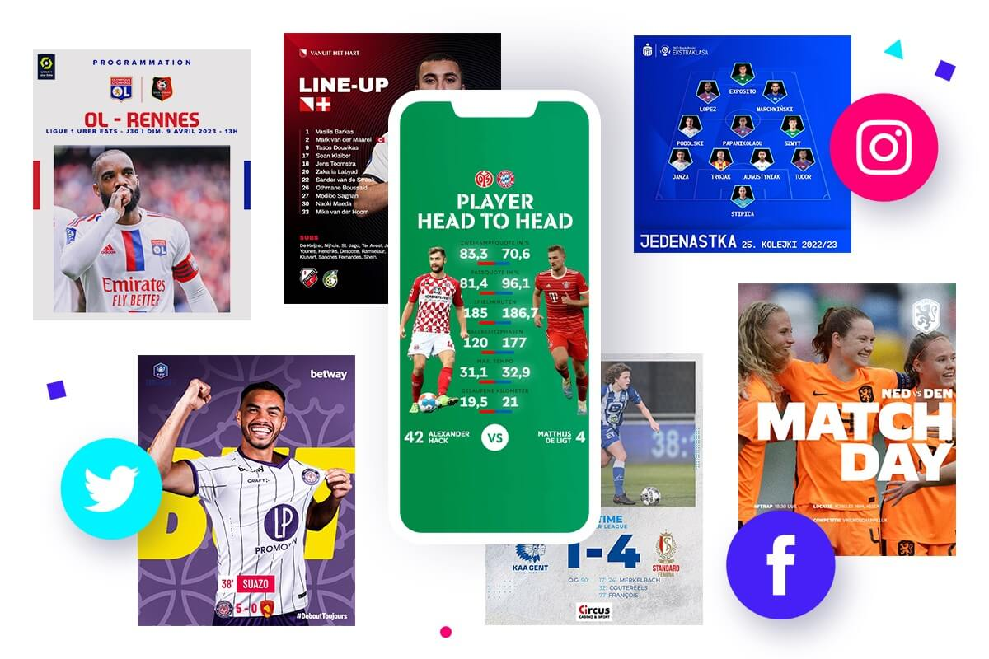
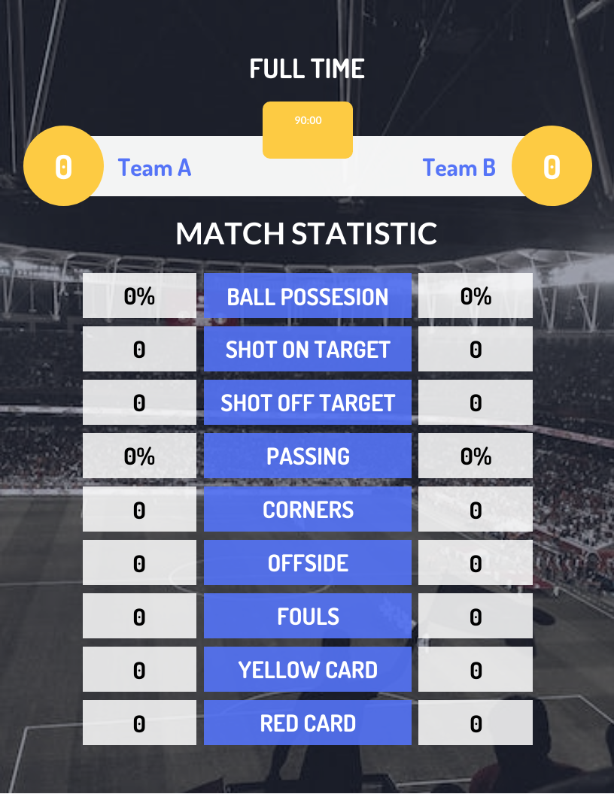
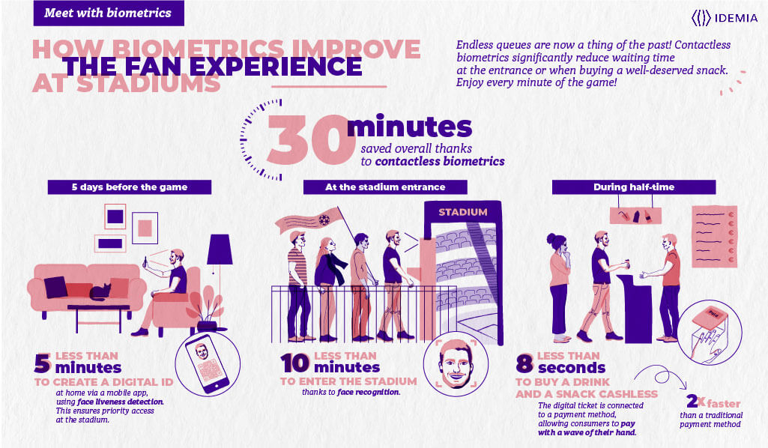
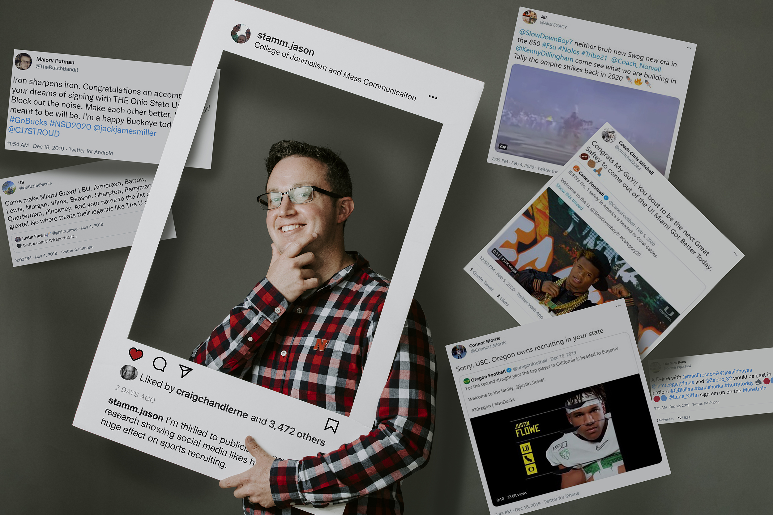
Revolutionizing Football Aspects
Fan Engagement
Real-Time Match Statistics
Social Media Integration
Interactive Apps & Platforms
IoT Enabled Stadiums
(Beukelaer, 2023)
(Venngage, n.d.)
(news.unl.edu, 2021)
(IDEMIA, 2021)

Slide 7
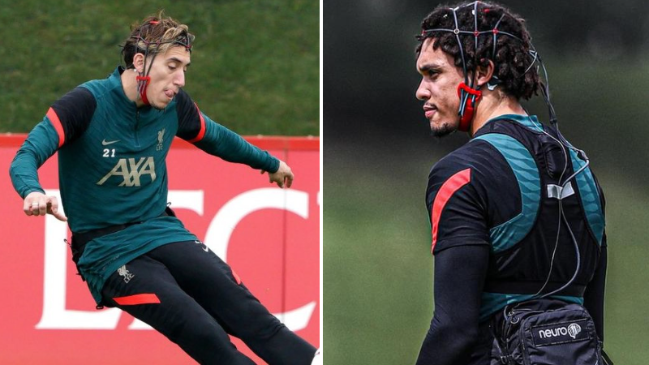
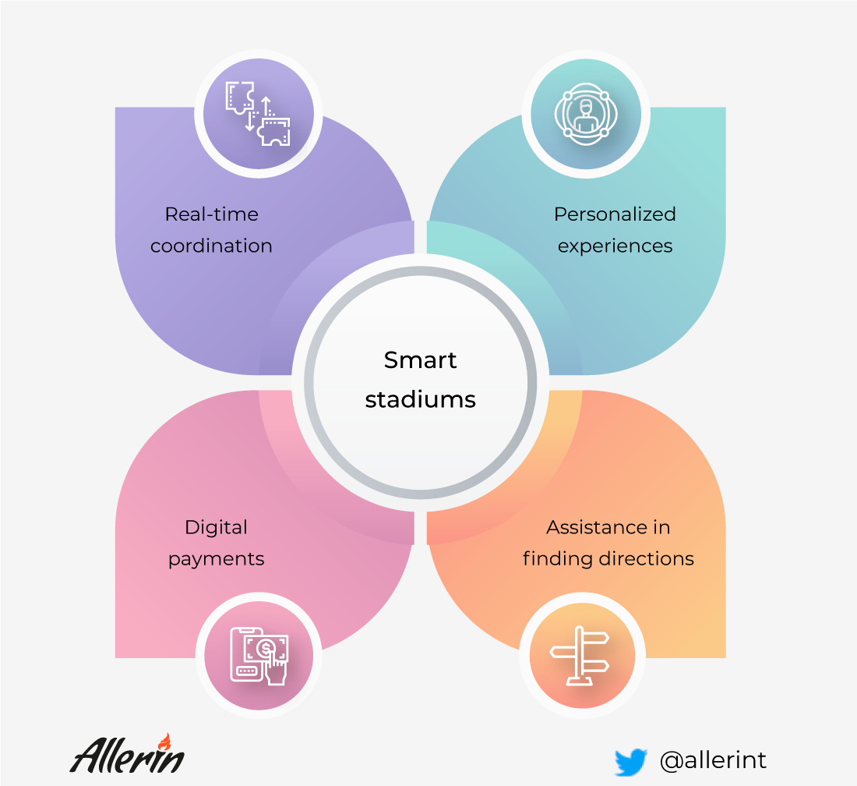
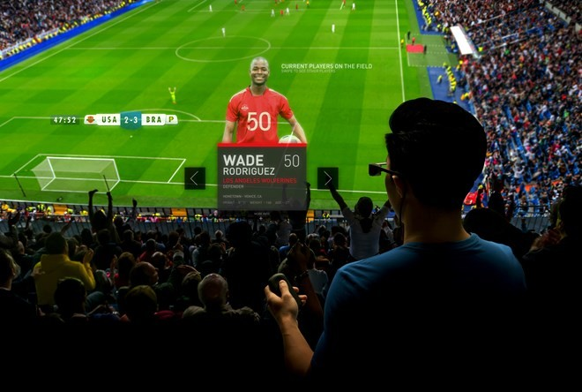
Revolutionizing Football Aspects
Future Innovations
Brain sensors
IoT Enhanced Stadiums
(SPORTbible, n.d.)
Augmented Reality
www.linkedin.com. (n.d.).
(ArchDaily, 2020)

Slide 8
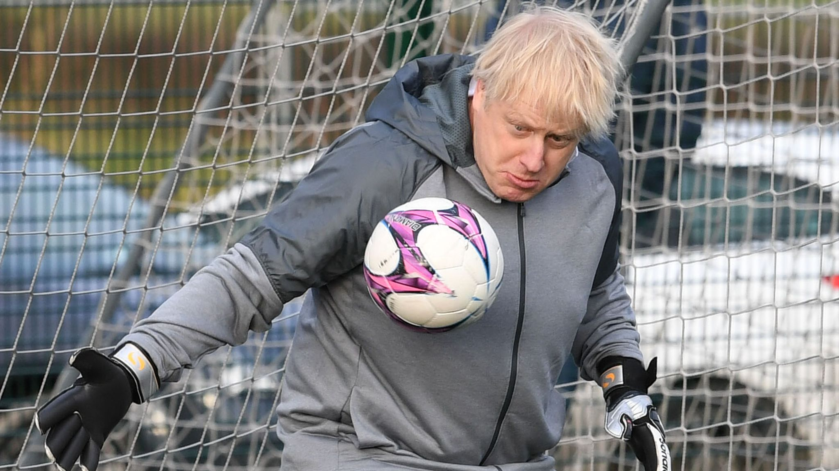
Future Challenges
Data Collection & Quality
Data Security & Privacy Concerns
Implementation Costs
Resistance to Change
(Sky Sports, n.d.)
Ten Hag: "Data is important in football, but at the end of the day I prefer my own eyes."

Slide 9
”How could the synergy of big data analytics, the Internet of Things (IoT), reshape football strategies, player performance analysis, and fan engagement? Additionally, what forthcoming challenges might arise in unlocking the complete potential of big data and IoT in the football industry?”
Conclusion

Slide 10
References
esupermk.live. (n.d.). 5890786 - Online Store. [online] Available at: https://esupermk.live/product_details/5890786.html [Accessed 8 Jan. 2024].
Muha, B. (2019). What is the IoT? Introduction to the Internet of Things. [online] Medium. Available at: https://medium.com/@bmuha1/what-is-the-iot-introduction-to-the-internet-of-things-57335391cd5f.
Wenao, L. (n.d.). English Premier League games only switched to CCTV Sports’ HD digital channel, not blocked - Global Times. [online] www.globaltimes.cn. Available at: https://www.globaltimes.cn/page/202007/1195444.shtml [Accessed 9 Jan. 2024].
Garry, T. (2022). Top 30 women’s footballers in Europe in 2022. The Telegraph. [online] 22 Dec. Available at: https://www.telegraph.co.uk/football/2022/12/22/top-30-womens-footballers-europe-2022/ [Accessed 9 Jan. 2024].
ESPN.com. (2022). Arteta’s Arsenal top red-card table as Gunners get 100th sending off. [online] Available at: https://www.espn.com/soccer/story/_/id/37624083/mikel-arteta-arsenal-top-red-card-table-gunners-get-100th-premier-league-sending-off [Accessed 9 Jan. 2024].
Football Today. (n.d.). Premier League Injuries. [online] Available at: https://footballtoday.com/premier-league-injuries/ [Accessed 9 Jan. 2024].
Rhodes, D. (2018). Set-Piece Shenanigans: Analysing The Reds’ Attacking Corners. [online] The Tomkins Times. Available at: https://tomkinstimes.com/2018/03/set-piece-shenanigans-analysing-the-reds-attacking-corners/ [Accessed 11 Jan. 2024].
www.sportbible.com. (n.d.). 10 Years Ago Today, Frank Lampard Had His Goal Ruled Out Against Germany In The World Cup. [online] Available at: https://www.sportbible.com/football/news-pub-talk-10-years-ago-frank-lampard-had-his-goal-ruled-out-against-germany-20200627.
Ramsay, G. (2022). How the ‘world’s most famous football’ became a ‘gift from God’ for former referee Ali Bin Nasser. [online] CNN. Available at: https://edition.cnn.com/2022/11/15/football/diego-maradona-hand-of-god-ball-auction-spt-intl/index.html.
Venngage. (n.d.). Dark Blue Match Statistics Soccer Football Template. [online] Available at: https://venngage.com/templates/posters/dark-blue-match-statistics-soccer-football-template-3636ac64-71fe-4c9d-b977-c9f8bbaf2917 [Accessed 11 Jan. 2024].
www.linkedin.com. (n.d.). Building smart sports venues with IoT. [online] Available at: https://www.linkedin.com/pulse/building-smart-sports-venues-iot-naveen-joshi/ [Accessed 11 Jan. 2024].

Slide 11
References Cont.
McCaskill, S. (2022). Gen Z digital natives interested in a greater variety of sport than previous generations. [online] SportsPro. Available at: https://www.sportspromedia.com/news/gen-z-streaming-laliga-nielsen/?zephr_sso_ott=VqQK81 [Accessed 9 Jan. 2024].
Wikipedia Contributors (2019). Goal-line technology. [online] Wikipedia. Available at: https://en.wikipedia.org/wiki/Goal-line_technology.
SPORTbible. (n.d.). Liverpool Players Using Brain Sensors To Ramp Up Champions League Final Preparations. [online] Available at: https://www.sportbible.com/football/liverpool-using-brain-sensors-to-prepare-for-champions-league-final-20220525.
www.joma-sport.com. (n.d.). Chest guard Gps black | JOMA®. [online] Available at: https://www.joma-sport.com/en_US/chest-guard-gps-black/100548.100.html [Accessed 9 Jan. 2024].
Sky Sports. (n.d.). VAR in spotlight once again as Liverpool, Arsenal and Wolves all face the harsh side of video technology. [online] Available at: https://www.skysports.com/football/news/11095/13001607/var-in-spotlight-once-again-as-liverpool-arsenal-and-wolves-all-face-the-harsh-side-of-video-technology [Accessed 10 Jan. 2024].
Sky News. (n.d.). Boris Johnson wants UK and Ireland to host 2030 World Cup and ‘bring football home’. [online] Available at: https://news.sky.com/story/pm-offers-britains-stadiums-for-all-of-the-european-championship-with-eyes-on-2030-world-cup-bid-12233217.
Kent, D. (2013). Celebrities who have pitched in... One Direction’s Tomlinson is not the only star to have entered the world of football. [online] Mail Online. Available at: https://www.dailymail.co.uk/sport/football/article-2383395/Louis-Tomlinson-celebrity-played-football.html [Accessed 10 Jan. 2024].
Admin (2022). How Technology Will Drive Greater Fan Engagement In Sports? [online] STL Tech. Available at: https://stl.tech/blog/how-technology-will-drive-greater-fan-engagement-in-sports/.
news.unl.edu. (2021). A thin (yard) line: Twitter reveals football fans’ love-hate stance on recruits. [online] Available at: https://news.unl.edu/newsrooms/today/article/a-thin-yard-line-twitter-reveals-football-fans-love-hate-stance-on-recruits/ [Accessed 11 Jan. 2024].
Beukelaer, O.D. (2023). Football social media: 15 content ideas and strategies. [online] Content Stadium. Available at: https://www.contentstadium.com/blog/football-social-media-content-ideas-strategies/.

Slide 12
References Cont.
ArchDaily. (2020). How AR and VR Will Enhance the Future of the Sports Arena Experience. [online] Available at: https://www.archdaily.com/941030/how-ar-and-vr-will-enhance-the-future-of-the-sports-arena-experience.
IDEMIA. (2021). Biometrics improve the stadium experience for fans. [online] Available at: https://www.idemia.com/infographic/how-biometrics-improve-stadium-experience-fans [Accessed 10 Jan. 2024].
Felices, A.M. (2023). Tracking Networks: A New Approach to Understanding Player and Team Performance. [online] Medium. Available at: https://medium.com/@marin11amf11/tracking-networks-a-new-approach-to-understanding-player-and-team-performance-87e248a69a41 [Accessed 11 Jan. 2024].
FC, A. (2022). Arsenal 2021/22: Out of Possession and Some Other Things. [online] Analytics FC. Available at: https://analyticsfc.co.uk/blog/2022/08/08/arsenal-2021-22-out-of-possession-and-some-other-things/ [Accessed 11 Jan. 2024].
Gallagher, C. (2021). Shot analysis: When Subbuteo meets Big data. [online] Flicking forever. Available at: https://www.flickingforever.net/training/subbuteo-tactics/shot-analysis/ [Accessed 11 Jan. 2024].
Worville, T. (n.d.). To duel or not to duel: Does winning your battles win you more games? [online] The Athletic. Available at: https://theathletic.com/2924763/2021/11/01/to-duel-or-not-to-duel-does-winning-your-battles-win-you-more-games/.
Wordpress.com. (2024). Available at: https://sportsengineer.files.wordpress.com/2022/05/zepp-sensor-top-image.jpg [Accessed 11 Jan. 2024].
Li, Y., Zheng, C., Liu, S., Huang, L., Fang, T., Li, J., Xu, F. and Li, F. (2020). Smart Glove Integrated with Tunable MWNTs/PDMS Fibers Made of a One-Step Extrusion Method for Finger Dexterity, Gesture, and Temperature Recognition. ACS Applied Materials & Interfaces, 12(21), pp.23764–23773. doi:https://doi.org/10.1021/acsami.0c08114.

Slide 13
Thank You

